Slide 1
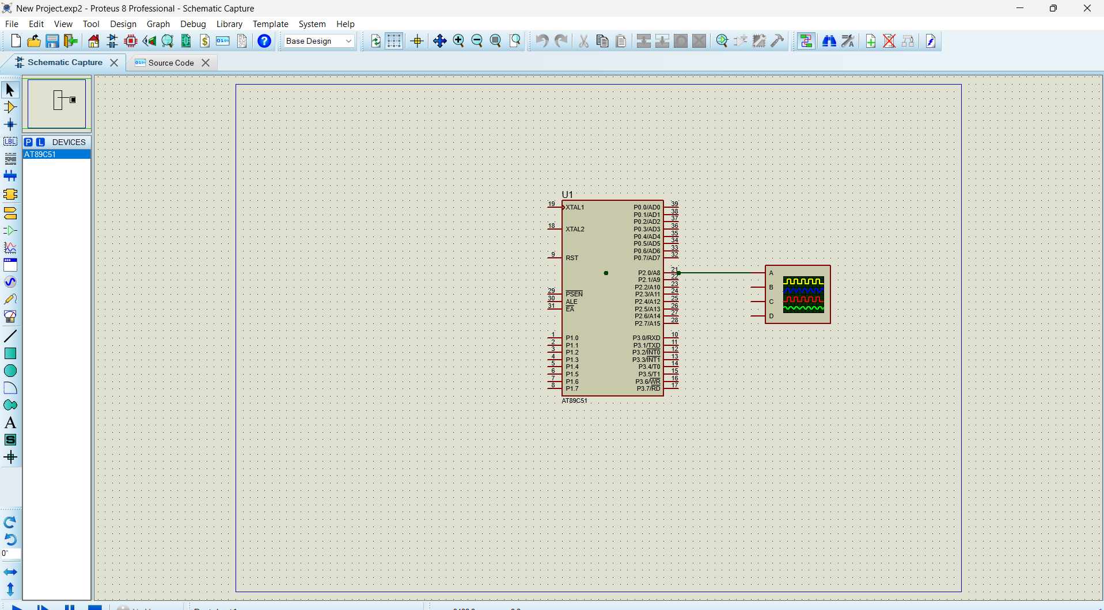
Objectives :-
To generate a square wave using AT89C51
To study port tagging operation
To observe wave form using an oscilloscope in proteus
CIRCUIT DIAGRAM
Program :-
ORG 0000H
UP: SETB P2.0
ACALL DELAY
CLR P2.0
ACALL DELAY
SJMP UP
DELAY: MOV R4,#35
H1:MOV R3,#255
H2:DJNZ R3,H2
DJNZ R4,H1
RET
END

